Slide 1
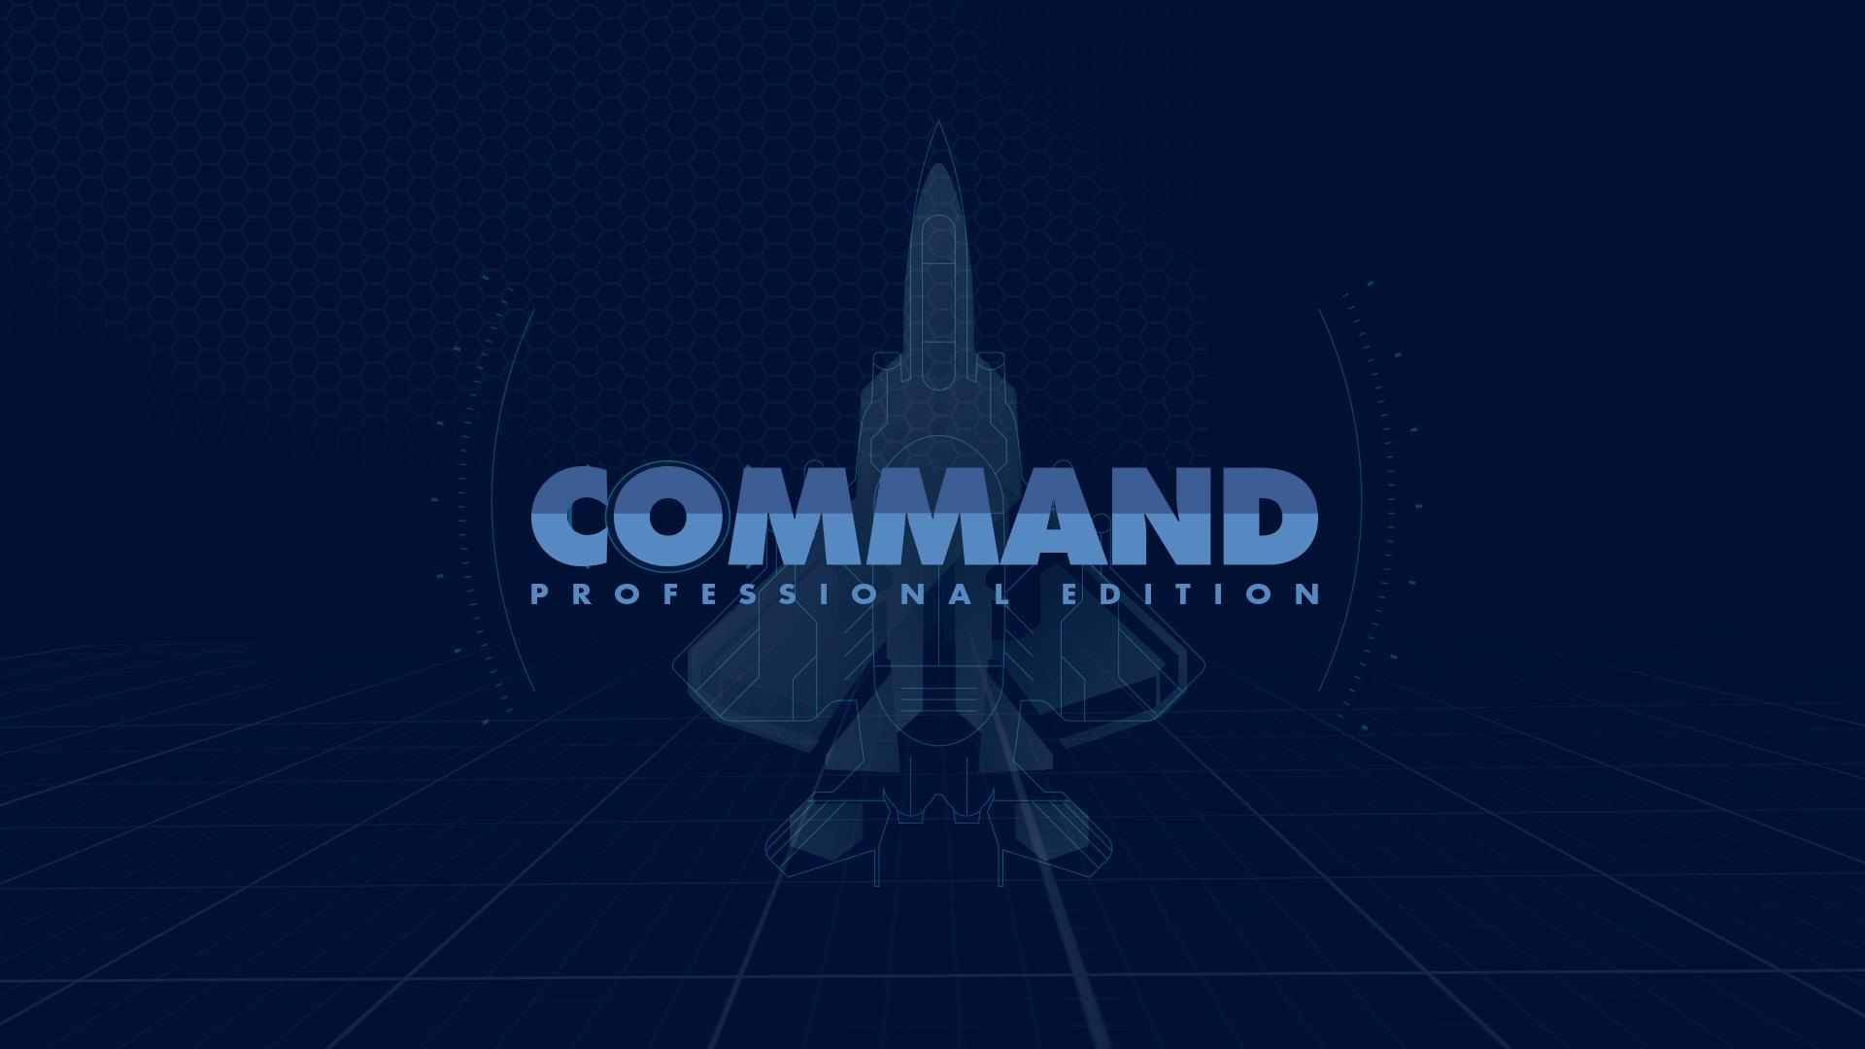

Slide 2
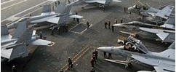
WHAT IS COMMAND PROFESSIONAL EDITION?
CMANO
01
Product
02
03
Contractors
Military
04
SUPERSET of Command: Modern Air/Naval Operations (CMANO)
Physics-based Battlespace Environment
Simulation tool.
Currently In use by US & NATO military contractors.
Logistics, training and analysis:
Currently in use by US & NATO Air and Naval Forces

Slide 3
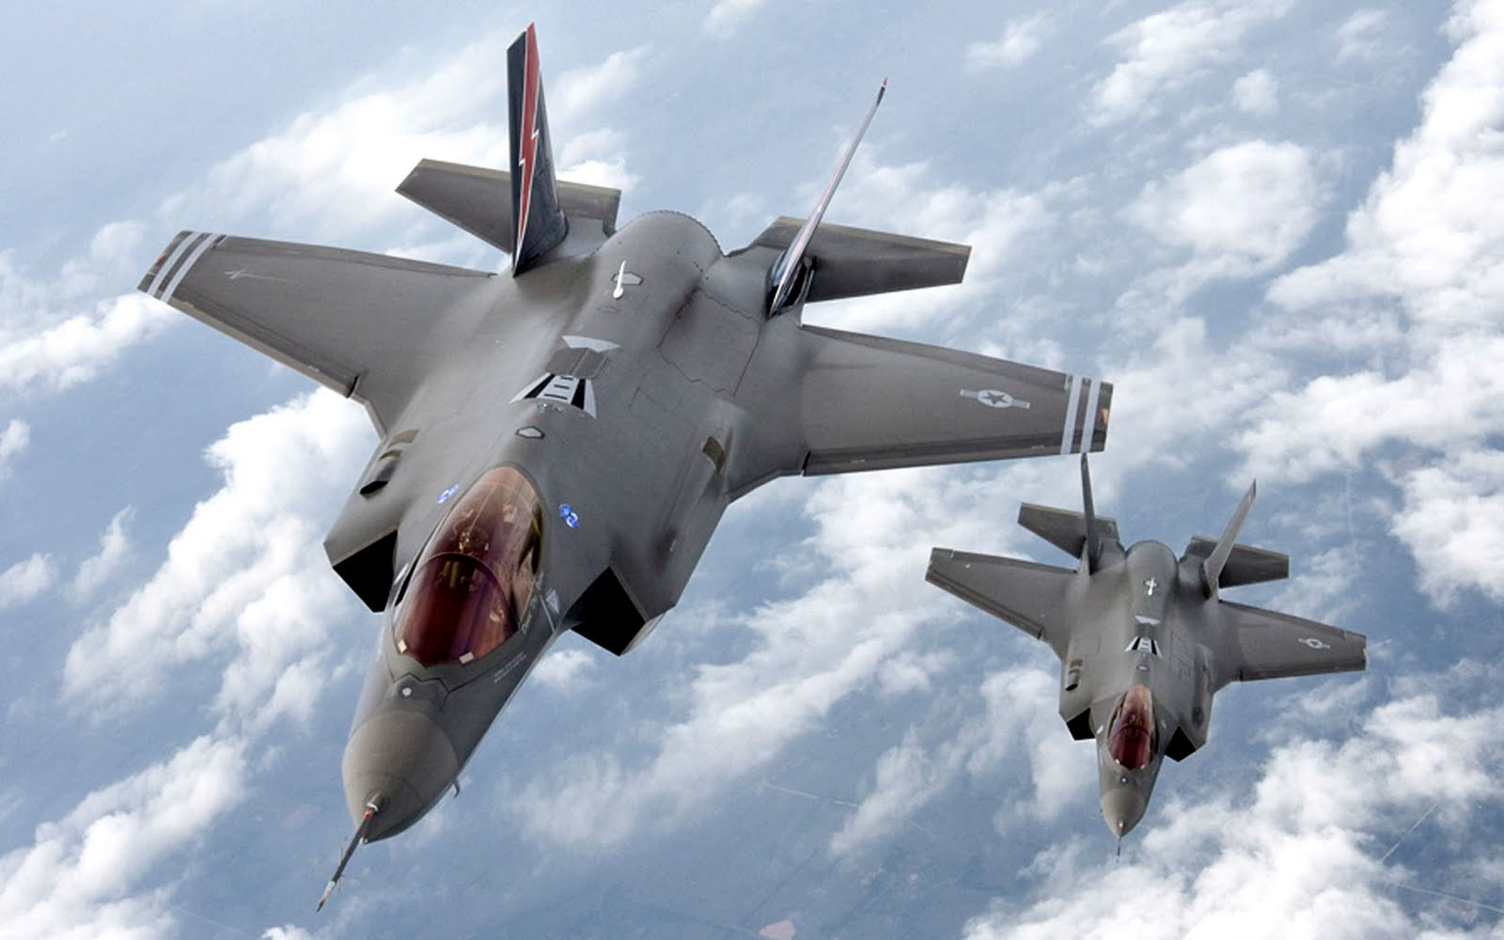
COMMAND PE BUILDS ON TOP OF COMMERCIAL CMANO
2
1
Praised
by the pros
Added-value features for the
academic/mil/gov professional

Slide 4
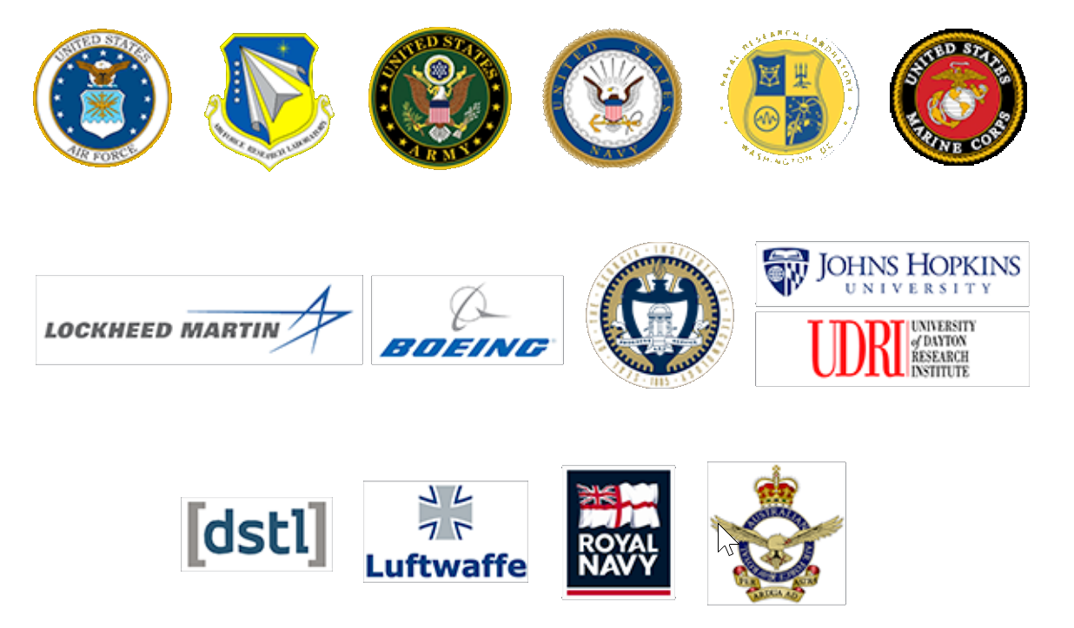
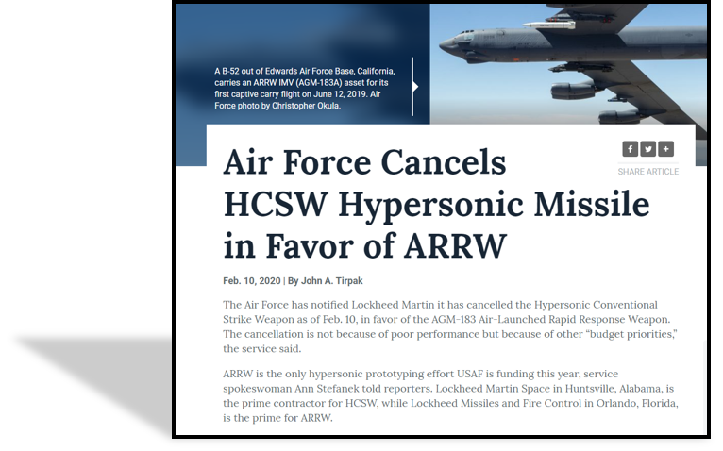
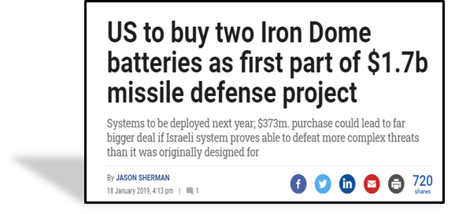
USED & TRUSTED WORLDWIDE
Armed forces & defence contractors throughout US & NATO use CPE for analysis, planning & procurement

Slide 5
PRAISED BY THE PROS:
“Far surpasses anything I have ever seen”
“This should be issued immediately to the field”
“In my 34 years of service, I’ve never seen anything like this”
“The 505th Command and Control Wing needs this”
CSAF ACP Senior Leader assessments
“Command will find a following not only among civilian gamers but might have value among military, government, and policy circles as a simulator of modern warfare”
US Naval Institute
“I would list the names of people who have been talking to me about this game for the last year, but I feel like I would be name dropping. Needless to say the range of people involved in beta testing range from an Admiral in the US Navy to professors at the US Naval War College to some distinguished Fellows of several think tanks”
Information Dissemination

Slide 6
FULL DATABASE EDITOR
120+
aircraft
facility types
2.500+
propulsion systems
600+
submarines
85+
satellites
260+
comm/datalink types
4.500+ aircraft
24.500+ loadouts
3.000+
ground units
& facilities
1.000+
warheads
5.500+ sensors
3.300+
weapons
3.000+ ships
all at your fingertips

Slide 7
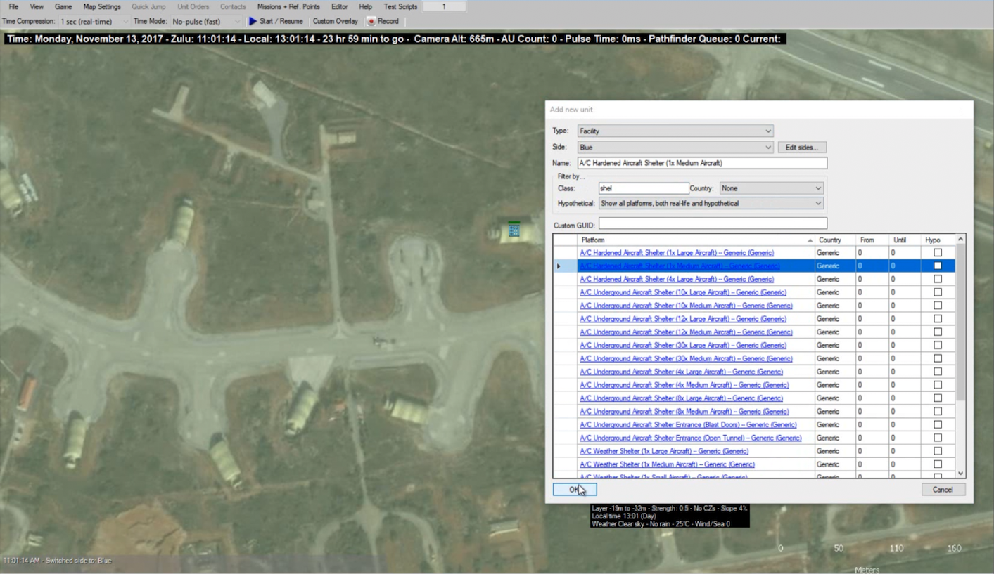
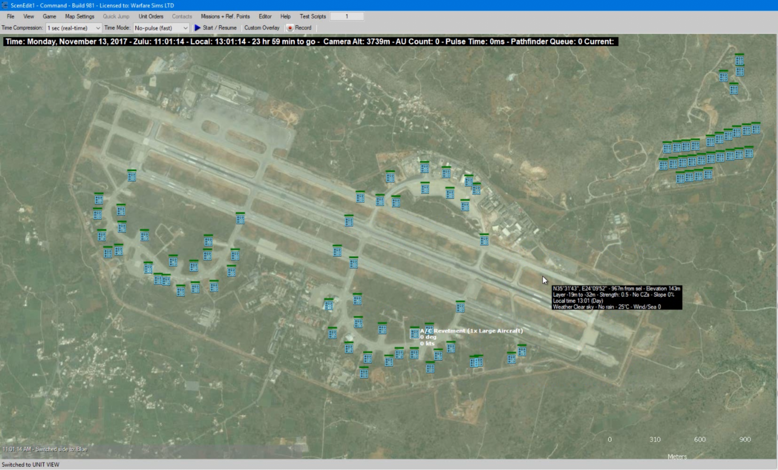
RAPID SCENARIO DEVELOPMENT
=
Powerful, GUI-driven integrated scenario editor allows creating elaborate scenarios in minutes
Save & re-use sprawling facility installations or nationwide defence complexes - or batch-import from your own data
Turbocharge creation speed with parallel development & scenario merging

Slide 8
ON-DEMAND FREE & COMMERCIAL IMAGERY
Bring your virtual battlespace to life with real-world imagery
Available Sources:
MS Bing Maps, or any OpenStreetMap-
compliant map source
Use publicly available, or
commercial imagery sources, or utilise your own private datasets
Interfaces to additional sources
can be implemented (e.g. Google Maps)
Place facilities at their
real-life coordinates with
pinpoint accuracy

Slide 9
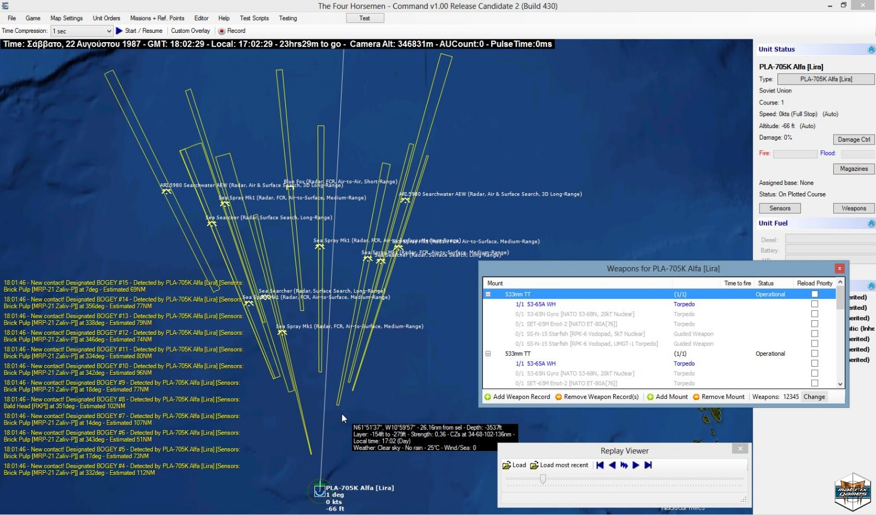
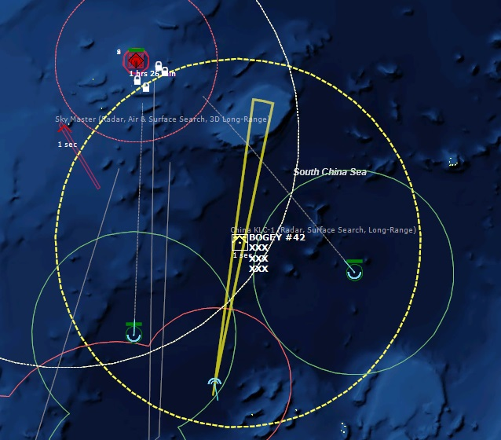
ANALYSIS: INTERACTIVE & MONTE-CARLO
Run any scenario 10 times or 100,000 times depending on need
High-performance simulation engine generates speedy results
Put your multicore supercomputer to good use with parallel execution
NEW IN v1.15: Command-
line interface for superfast automated analysis
Use “butchers bill” to assess losses and weapon expenditures,
or drill-down deeper to examine events and their causes

Slide 10
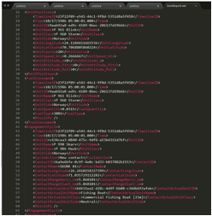
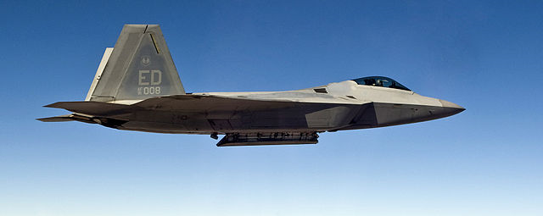
EVENT EXPORT
Export to XML,
CSV, MS-Access,
Tacview
Export various sim events for external analysis; unit positions
& movements,
fuel consumption, weapons fired, units hit/destroyed, fuel transfer and much more
More destinations
available on request
e.g. SQL Server,
Oracle etc.

Slide 11
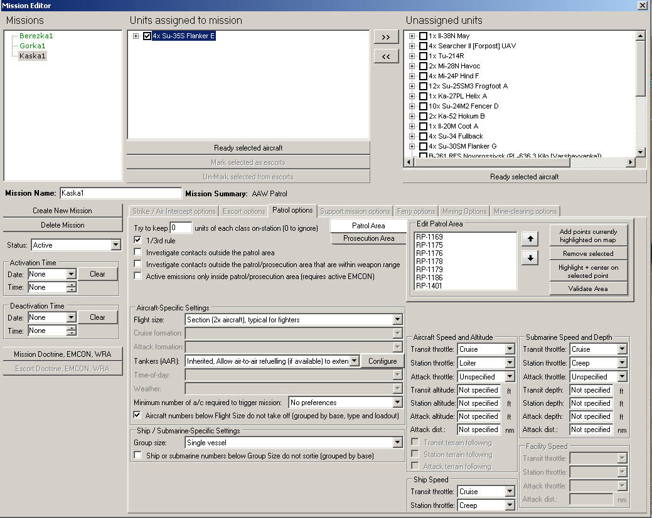
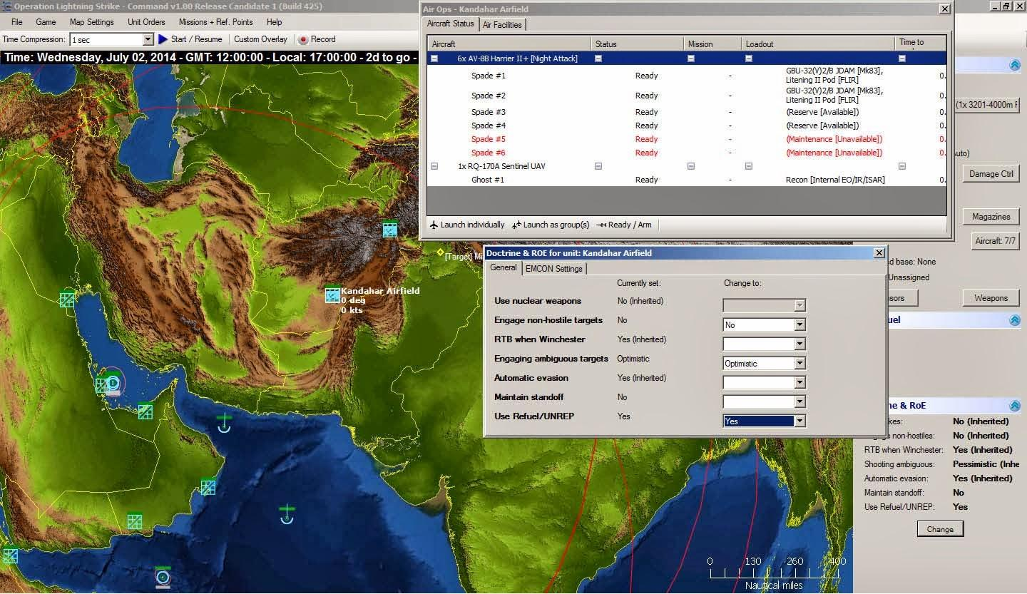
EDIT & CUSTOMIZE THE SIMULATION
Multiple ways of customizing data & models:
Mechanics overrides
Direct editing
of raw scenario
state (via XML)
DB editor
Lua plugin API

Slide 12
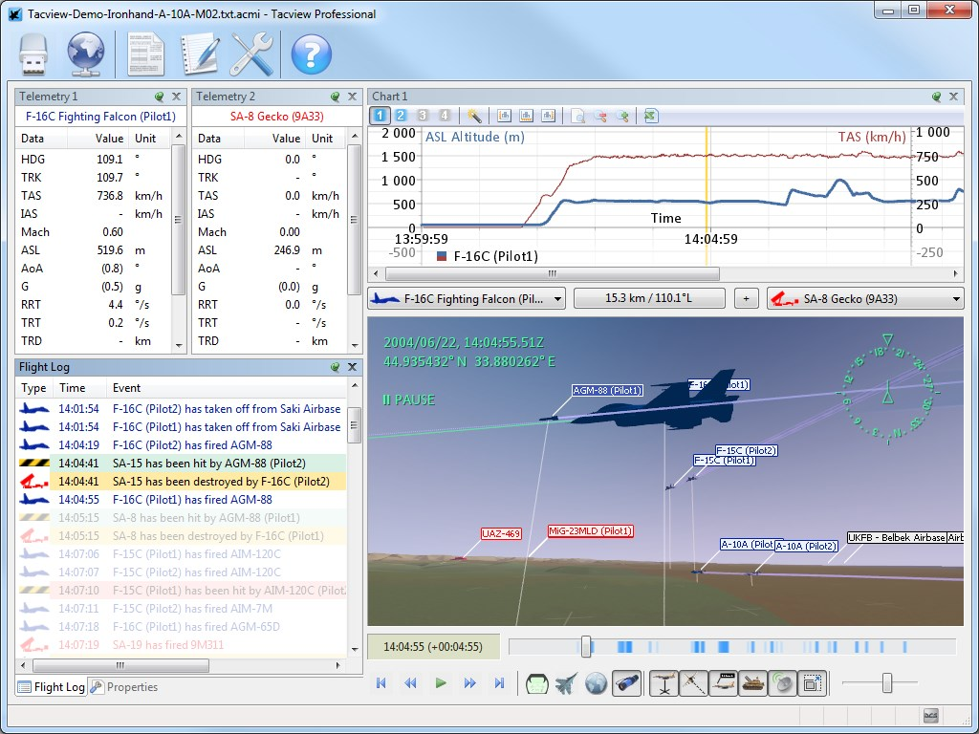
PLUG-IN YOUR OWN MODEL: MECHANICS OVERRIDES
Create and edit
your own models & mechanics using
Mechanics overrides, in-code, or remote connection to Lua API.
Overrides configurable per session - Additional methods can be added on request.

Slide 13
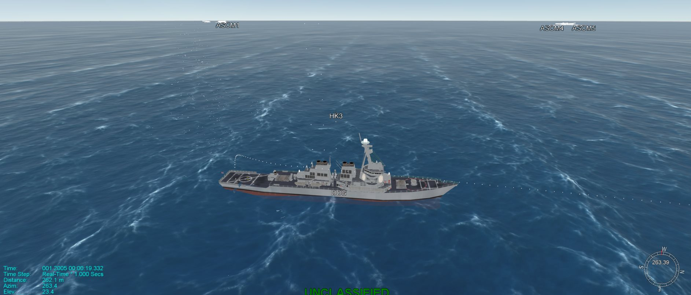
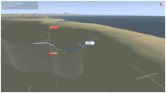
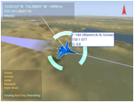
RICH 3d VISUALIZATION - EXPANDED OPTIONS
Export simulations to
Tacview, SIMDIS or ANY
DIS-compatible viewer for
comprehensive, all-aspect
3D view of the battlefield
Go forwards or backwards
in time and observe trends
and subtle factors
Stand back and observe the
big picture, or zoom-in for more detail or pan from a different
angle to view a new perspective
After-action and real-TIme
modes supported - CIGI support in future

Slide 14
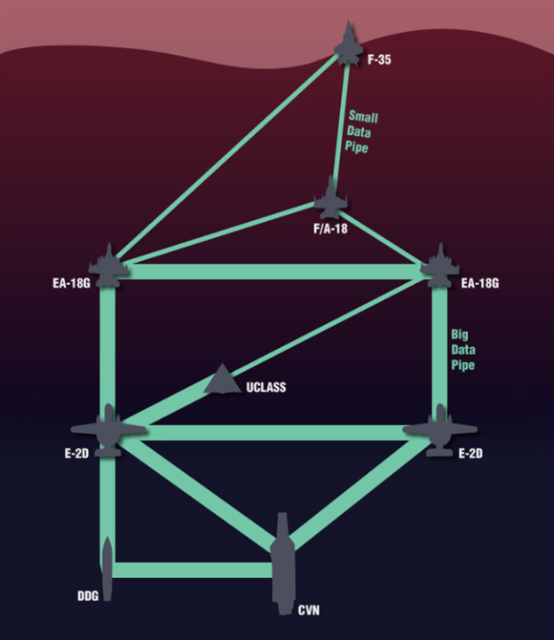
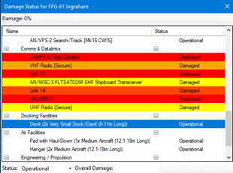
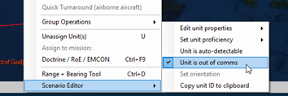
COMMUNICATIONS JAMMING & DISRUPTION
How well can your forces operate in the dark?
Communication jamming & disruption and out-of-contact units explicitly modelled
Units are not entirely blind, they can still fight alone, but the advantages of teaming, fire coordination etc. are lost; ops efficiency is severely degraded
Execute in different ways: either broadly via comms jamming, or more specifically through Lua scripting e.g. cyber/network attack!
Allows analysis of disrupted comms networks
Future options: Isolated local-area networks, variable comm quality/data rates

Slide 15
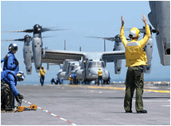
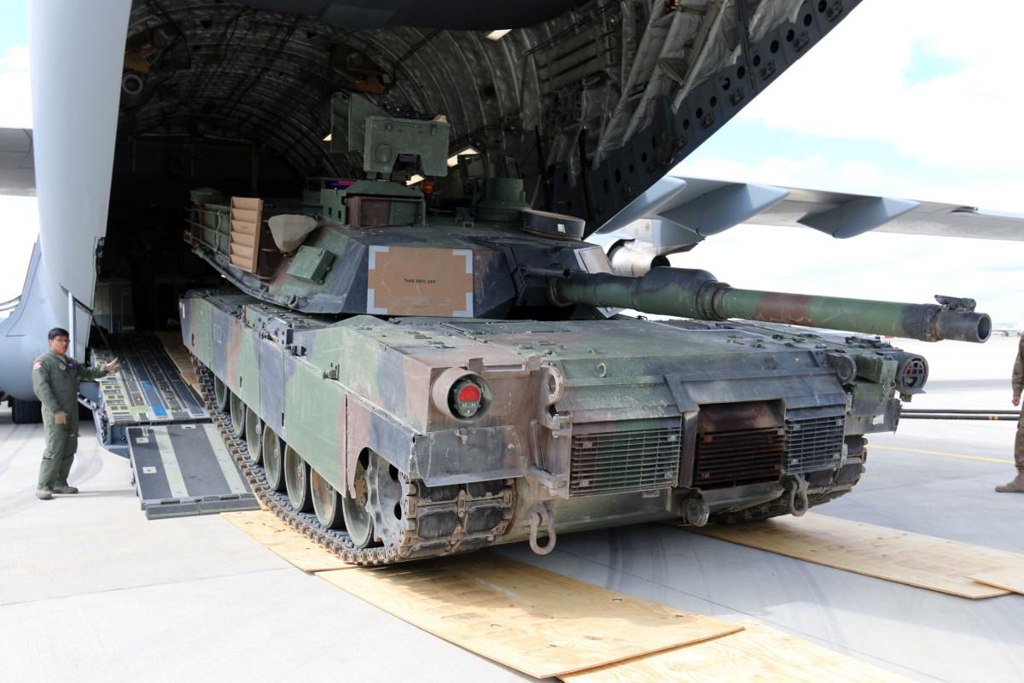
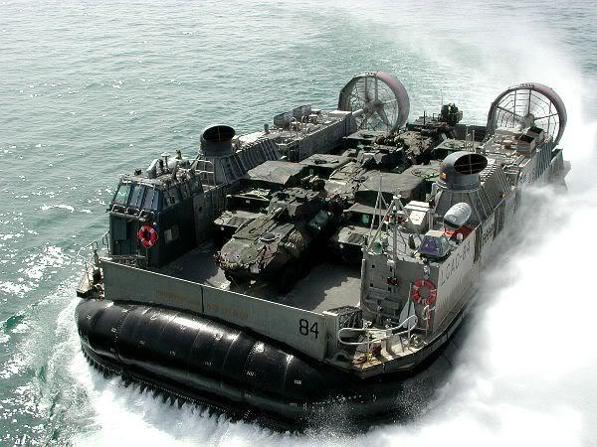
TACTICAL / OPERATIONAL LOGISTICS & CARGO
Getting your forces to the theater - and sustaining them
Units have finite weapons, fuel & stores - consider your
staging ports & bases
carefully
Rich cargo model places realistic volume/weight/personnel restrictions on your supply chain capacity
Amphibious landings and airdrops: Perform multi-dimensional, multi-domain manouvering to secure your objectives

Slide 16
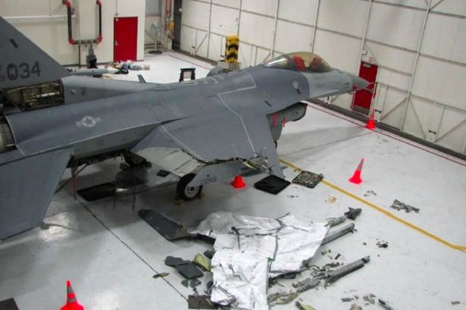
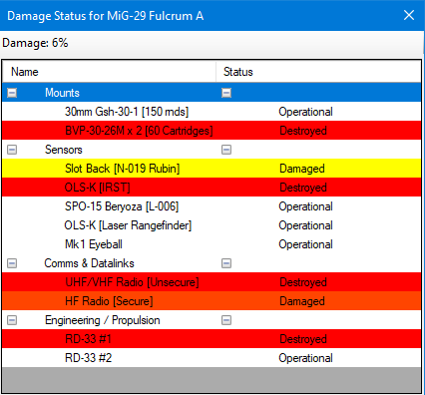
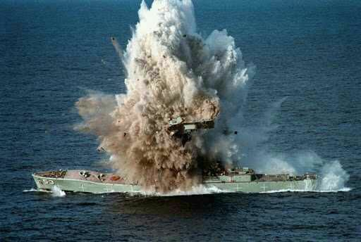
DETAILED DAMAGE AND TURN-AROUND
Live to fight another day
All platforms are complex systems made of discrete components - each individually damaged/destroyed
Surviving units may return to ports/airbases/carriers to repair, refuel
& re-arm - But this costs time!
Discrete armour levels for hull/superstructure/fuselage etc. and per-component
Use Command’s built-in ETIC & turn-around estimators, or override with your own data/models

Slide 17
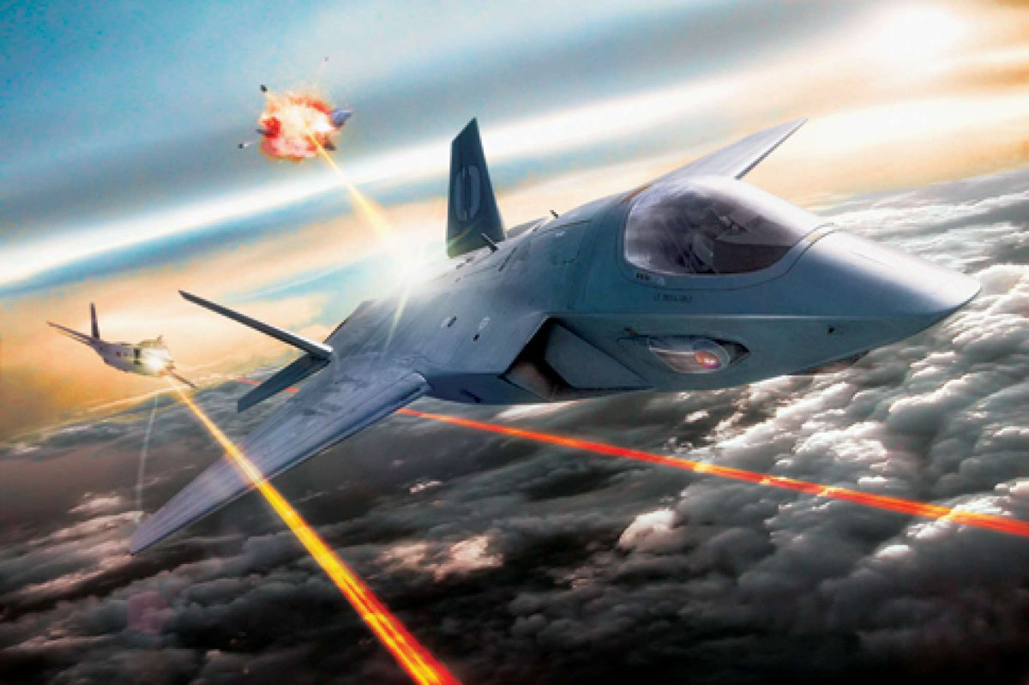
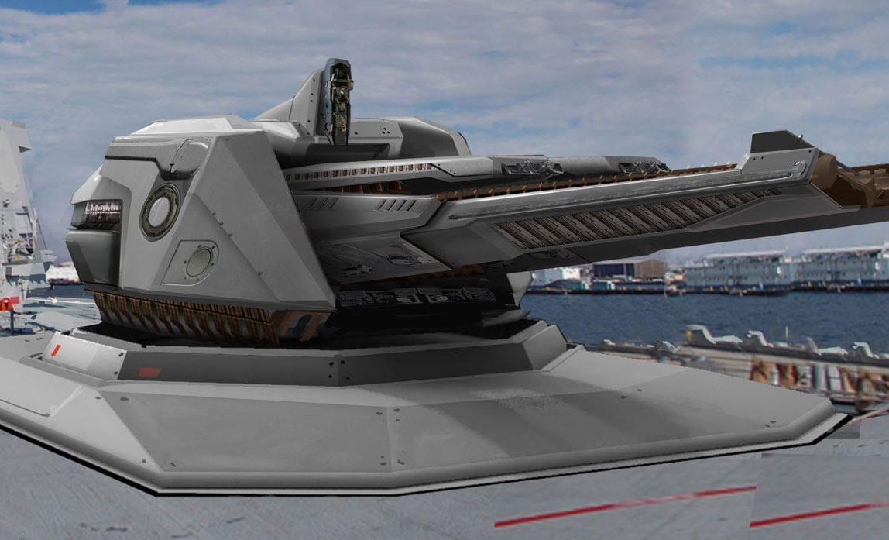
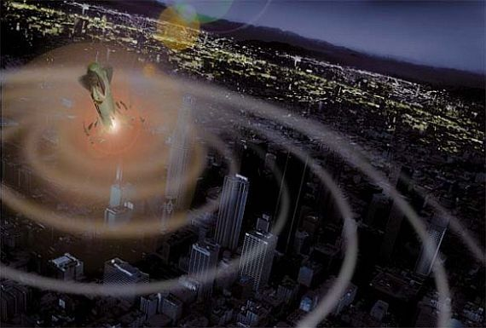
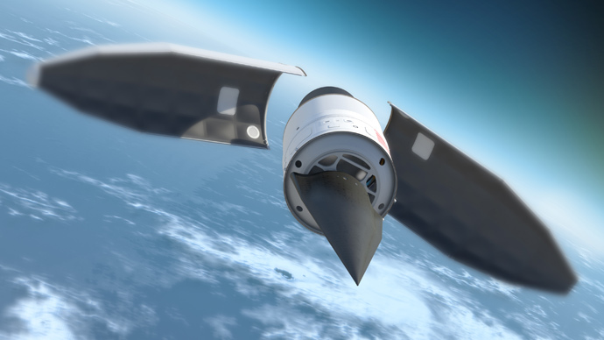
1
2
3
4
WEAPONS OF THE PRESENT & THE FUTURE
New Weapon Types
High energy lasers - multiple subtypes, each with its own
peculiarities
Tactical EMP weapons, both omni-directional “grenade” warheads and directional systems like CHAMP
Hypersonic Glide Vehicles
Railguns and HVPs

Slide 18
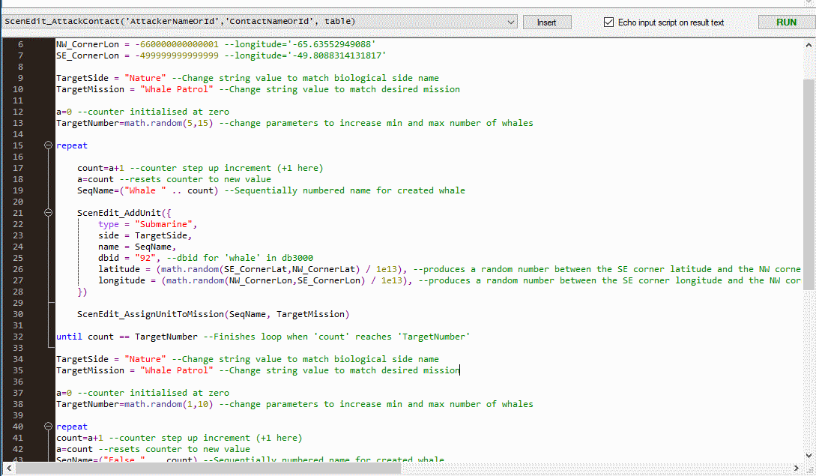
LUA SCRIPTING & PLUGIN API
Go beyond the graphical interface
Built-in Lua console provides direct access to the internals of the running simulation
TCP/IP socket
access to Lua API – remote-control Command from any external console or application
Script commands can be either human- or machine-driven
(HAL or WOPR/Joshua as adversary!)
Lua I/O (optional) – use any of Lua’s built-in input/output abilities to facilitate information import & export

Slide 19
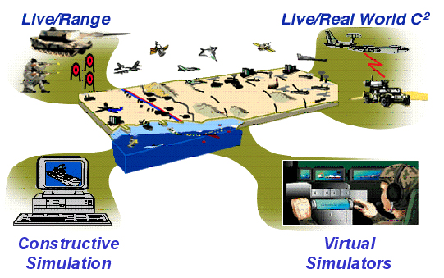
INTER-SIMULATION CONNECTIVITY & INTEGRATION
Talks to what you already use
Join existing distributed simulations through DIS
(v6 & v7 support)
TCP/IP socket access to Lua API – remote-control Command from any external console or application
Complete import/export of scenario state via XML:
allows changes to everything
Mechanics Overrides: Use your siloed data & models directly inside Command
Rich event-export framework
to output data to other existing systems
Future Growth: HLA, CIGI,
other

Slide 20
CONTACTS
For further information please contact:
JD McNeil CFO Matrix Games
jdm@matrixgames.com
Tel USA +1 719 559 9591
UK +44 1372 898025 x1001

